Slide 1
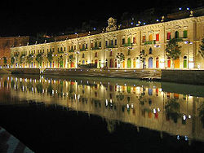
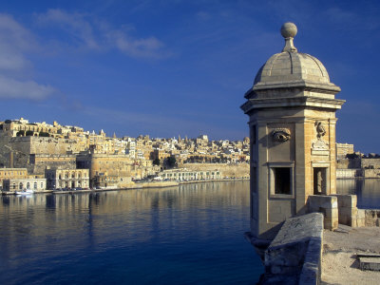
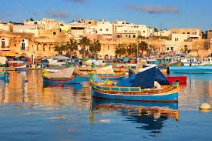
Internship in Malta in the TOURISM field
Make your experience count!

Slide 2
Tourism in Malta
Tourism in Malta is an important sector of the country's economy, contributing to about 15 % of the nation's GDP.
Last year (2012), Malta had an all time record for tourism in Malta (1.44 million tourists).
The industry continues to be resilient and the first two quarters of this year have already proved to be another record year with a 10% increase on the figures in 2012.
Tourism in Malta is starting to carve its niche in the world of travel.

Slide 3
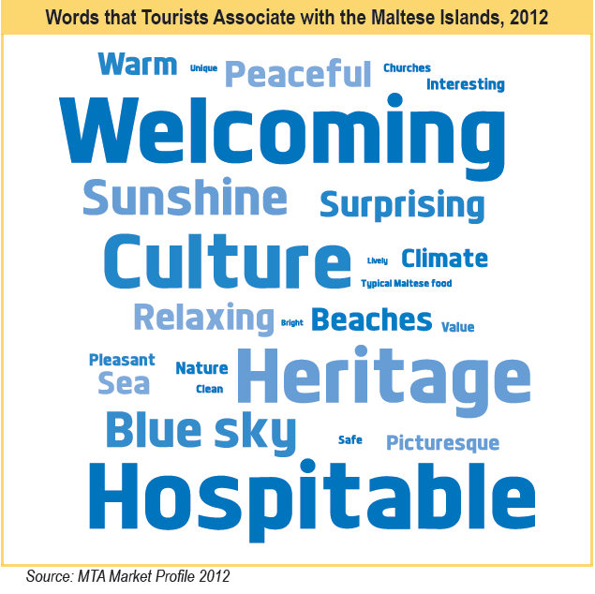
YOUR BRIEF MALTA EXPERIENCE IS A CLICK AWAY
http://youtu.be/cxO_iMBmprw

Slide 4
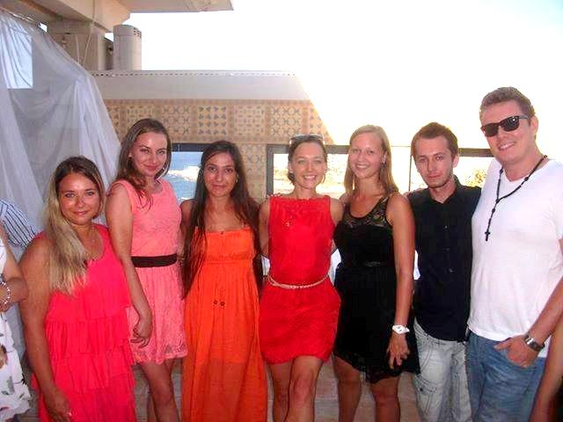
Internship Programme in Malta
Paragon Europe manages successful INTERNSHIP PROGRAMMES Leonardo da Vinci and ERASMUS mostly acting as a receiving company.
Through our experience of 8 years, today we are collaborating with more than 1500 partner companies in all sectors in Malta.
We offer a placement starting from 3 weeks with practical work experience in line with your chosen area and shared accommodation in fully equipped apartments in close proximity to work placement, shopping, clinic and entertainment outlets.
Paragon has a dedicated and experienced support team that takes care of all the administration and logistics with continuous monitoring of the students during their work placement
Students will also benefit from learning English whilst doing their valuable work experience.

Slide 5
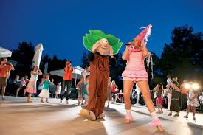
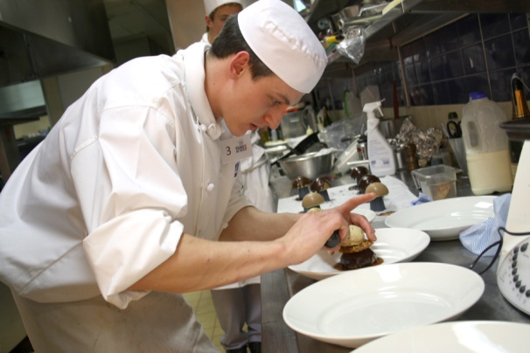
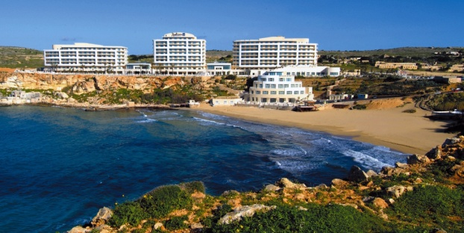
Placement Areas in Tourism
Hospitality, Restaurants, Bars, Front Office, Reservations, Housekeeping, Event and Recreation Management, Sustainable Tourism, Amusement and animation, Chefs, Travel agent, Tourism Marketing, Museums and Historical Sites

Slide 6
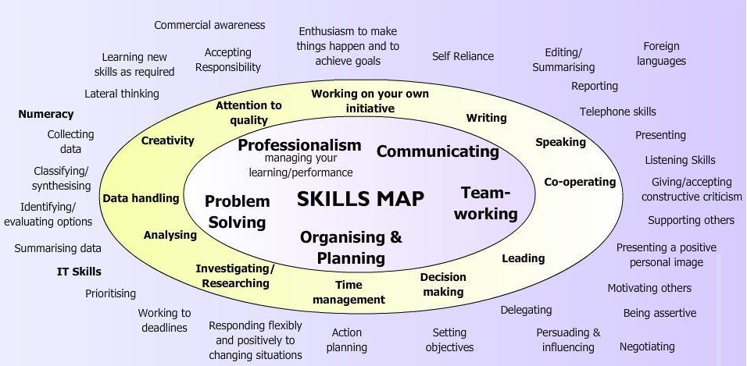
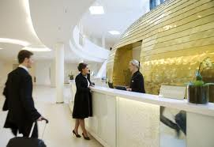
Best Hotels, Travel Agencies, Museums, Theatres & Tourism Stakeholders

Slide 7
Reception (Front Office)
The opportunity to work in one of our high standard 4 or 5 star partner hotels.
From 3 weeks to one year at any given time of year.
Check-in/out
Rooming of all guests
Cashiering
Foreign Exchange
Assist guests with enquires
Benefit from learning how to work effectively in a team, develop strong customer service and good problem solving skills, whilst practicing European languages, especially English.

Slide 8
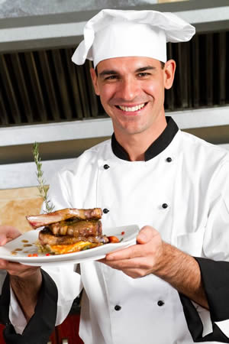
Chef
Work in a 5 star environment and gain experience in all kitchen departments.
Learn about cooking techniques whilst assisting the executive chef.
Gain the confidence, experience and essential skills needed to purse a career as a chef:
The sous vide technique.
Keeping kitchen equipment, tools and practices sanitary.
Proper temperature control when handling all meat, fish and vegetables.
How to select and procure quality ingredients.

Slide 9
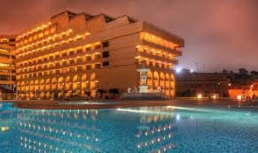
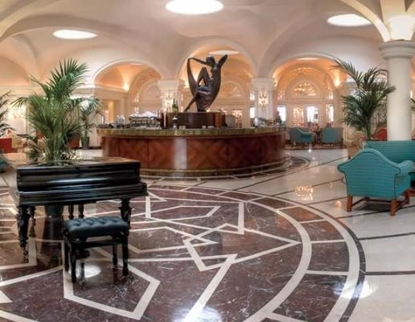
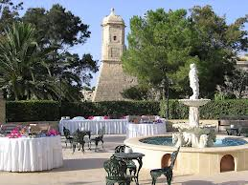
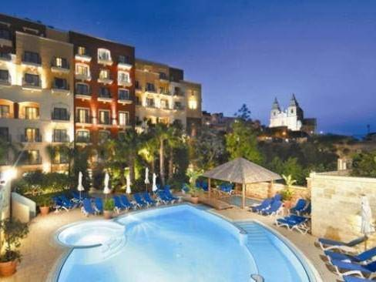
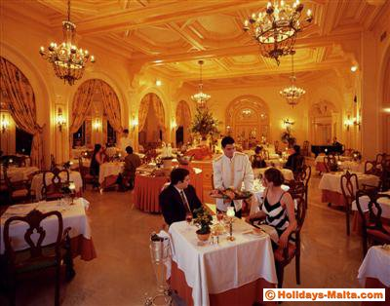
Some of our 5 Star Hotel Partners in Malta

Slide 10
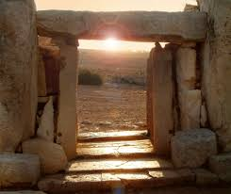
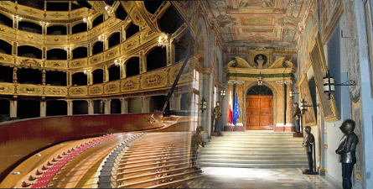
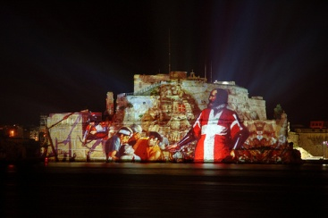
Museums, Theatres & Heritage Sites
Front office (reception)
Hosts
Curator Assistant
Guides
Restoration.
7000 years of
History
If you want to sharpen your customer skills, be creative and work in cultural heritage whilst receiving a structured training, this is the perfect internship for you!
9 UNESCO World Heritage Sites

Slide 11
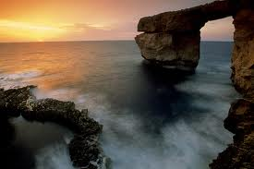
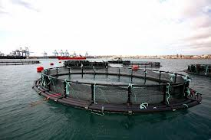
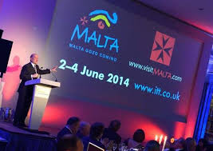
Sustainable Tourism
Internships for students who want to work in EU Projects and Policy Developments on Sustainable Tourism.
There are various Projects and Policies launched in recent years to make as low an impact on the Maltese environment as possible, but retain a positive outcome for local people, tourism companies and the tourists.
Be a part of this new emerging phenomenon and gain life-long learning skills of how to put greener tourism in practice.

Slide 12
Testimonials
INTERN
“With regards to the student with us, she is doing fine and learning a lot, not just accounting, but also those -what I call - common sense facts of life, that will help her in any job that she will do in future.
As you well know, Larissa is with us until early January 2014. I would like to ask you whether you have any other suitable candidates to do an internship in our accounts department for a long stretch of time.”
Look forward to hear from you soon,
Joe Zahra,
Accountant Alpine Travel & Tourism.
“I found this place as a unique possibility to spend your summer time both with pleasure and useful experience during my stay. I gained important professional skills at my work placement as well as unforgettable memories and new friends. But remember, all depends on how active you are.”
Pavlo Skakun
Jagiellonian University
Poland
HOST COMPANY

Slide 13
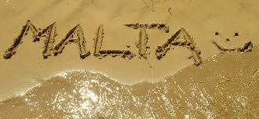
Thank you for your attention
E-mail us today to avoid any disappointment
info@paragoneurope.eu

